Slide 1
Novel Method for Liveliness Detection Using a Dynamically Changing UI and Gaze Tracking
By Team Pure Regression

Slide 2
WHY
Livelines detection is a well researched field and is extremely important for security.
With the increasing number of crimes, liveliness detection has become an unsaid necessity.
Non-intrusive methods of detection are not 100% effective many reasons such as lighting, etc that affect camera feed.
Intrusive methods of liveliness detection are expensive and hard to setup.
There is a need to increase the accuracy of detection without compromising on the user’s experience of the system.

Slide 3
WHAT
The human eye is adept at tracking motion of objects.
Similar to real life, the eyes try to track different motions while looking at a screen.
The user’s responses to the animations/changes on screen act as a measure of liveliness.
Additionally, if the animations/changes occur randomly without a fixed pattern it will be almost impossible to impersonate correct reactions.
And if the animations/changes are done in a correct way, although intrusive, will feel smooth and non-obstructive to the user.
Thus we are building a dynamically changing interface and an gaze tracking algorithm which can understand the liveliness of a person based on his eye’s responses to the UI, without compromising on the usability of the UI itself.

Slide 4
HOW - Background Research
A saccade is a quick, simultaneous movement of both eyes between two or more phases of fixation in the same direction.
Humans and many animals do not look at a scene in fixed steadiness; instead, the eyes move around, locating interesting parts of the scene and building up a mental, three-dimensional 'map' corresponding to the scene.
Saccades may rotate the eyes in any direction to relocate gaze direction (the direction of sight that corresponds to the fovea), but normally saccades do not rotate the eyes torsionally.
We noticed the same phenomenon occurring while users were looking at a screen (phone/monitor).

Slide 5
HOW - Dynamic UI
Fast/sudden motion/changes on the UI aren’t necessary.
The UI can make use of animations and smooth transitions to grab user attention.
The UI animates common on screen elements so that the user is not alienated by it.
Elements such as loading bars, drop downs, touch animations, screen transitions etc can be utilized for this purpose.
A generic all encompassing framework can be built to manage the dynamic state of the UI.
Currently the UI uses basic elements to grab user attention.

Slide 6
HOW - Gaze Tracking
We aim to develop a complete gaze tracking algorithm.
Currently though we have developed an iris tracking algorithm which can predict the overall motion vector for users eyes.
Haar cascade classifiers were used for this purpose.
Further image registration to compensate for face motion (when phone/user is not stationary) was carried out which gives acceptable results.
We aim to further predict the user gaze by taking camera position as reference in a virtual 3d space

Slide 7
HOW - Liveliness Detection
Once we get the trail of users gaze through the video clip using gaze tracking, we co-relate it with the dynamic changes made in the UI for that session.
We use the correctness in the 2 patterns to classify between a live and fake user.
For this currently thresholding on motion vector values is used.
Later, we aim to utilize collected video feeds from actual mobile applications and train a binary classifier for prediction.
Also additional checks for non human like motion have been created.

Slide 8
Research
https://www.ncbi.nlm.nih.gov/m/pubmed/1455739/ [Saccadic eye movement]
https://www.sciencedirect.com/science/article/pii/S0042698907001939 [Eye movements on rapid stimulus]
https://www.scientificamerican.com/article/eye-tracking-software-may-reveal-autism-and-other-brain-disorders/ [Medical use of eye tracking]
https://www.ncbi.nlm.nih.gov/m/pubmed/9532965/?i=2&from=/2017572/related [Effects of intermittent illumination]
https://www.usability.gov/how-to-and-tools/methods/eye-tracking.html [Eye tracking used for understanding user engagement on websites]
Saccade landing point selection and the competition account of pro- and antisaccade generation: The involvement of visual attention – A review by ÁRNI KRISTJÁNSSON
SearchGazer: Webcam Eye Tracking for Remote Studies of Web Search by A Papoutsaki

Slide 9
Current Status
Completed:
Basic android app with dynamically flashing UI elements and file transfer to cloud.
Server side code in NodeJS to manage connections (HTTP and Web sockets) and initiate image processing.
Python script using OpenCV for iris tracking and liveliness detection.
Resource Links
Github repo [https://github.com/rohitbhaskar/face_liveliness_detection]
All codes
Readme for installation instructions
Demo video and presentation slides

Slide 10
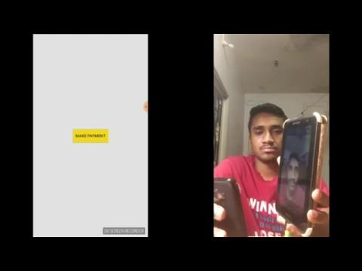
Demo

Slide 11
Future Work
Scalable and Fast Server Scripts (High Loads)
Improve performance by dynamic video stabilization
Model more complex gaze patterns
Gaze prediction to enable auto learning

